Slide 1

Revolutionizing Topic Modeling:
Comparing ChatGPT and Machine Learning Models on Categorized Data Sets
By : Nishtha Gupta

Slide 2
Introduction
Topic modeling finds latent topics in large text datasets.
Traditional machine learning may struggle with complex, multi-category data.
ChatGPT is a cutting-edge language model for topic modeling.
This study compares ChatGPT with traditional machine learning models.
The study aims to evaluate ChatGPT's accuracy and efficiency.
Results will help understand ChatGPT's effectiveness with categorized data.

Slide 3
Steps for Traditional Topic Modeling using LSTM
PRE-PROCESS
Prepare the text data by cleaning, preprocessing, and tokenizing it.
EMBEDDING
Convert the tokenized text into a sequence of word embeddings.
LSTM TRAINING
Train the LSTM model using the sequence of word embeddings.
Topic Labeling
Extract and label topics by clustering the word embeddings generated by the LSTM model.
Prediction
Evaluate the performance of the model and use it to predict topics for new text data.

Slide 4
Steps to use OpenAI's GPT library for chat completions
Install the OpenAI Python library and authenticate the OpenAI API.
Evaluate the results and integrate the chat completions into your application or system.
05
01
04
Generate chat completions by calling the generate function.
Create an instance of the GPT class and select the model you want to use
02
03
Set parameters for chat completions, such as the prompt and the maximum number of tokens to generate.

Slide 5
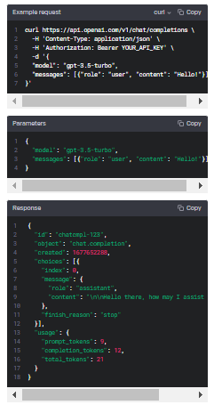
OpenAPI GPT Chat Completions
The OpenAI GPT Chat Completions API generates text completions based on a given prompt.
It can be used to develop chatbots, writing assistants, and other applications that require natural language generation.
The API uses deep learning techniques to generate contextually relevant and coherent responses.
It can handle long-form text and is suitable for use in applications such as customer support chatbots.
Overall, the OpenAI GPT Chat Completions API provides a flexible tool for generating natural language responses that can be integrated into a variety of applications.

Slide 6
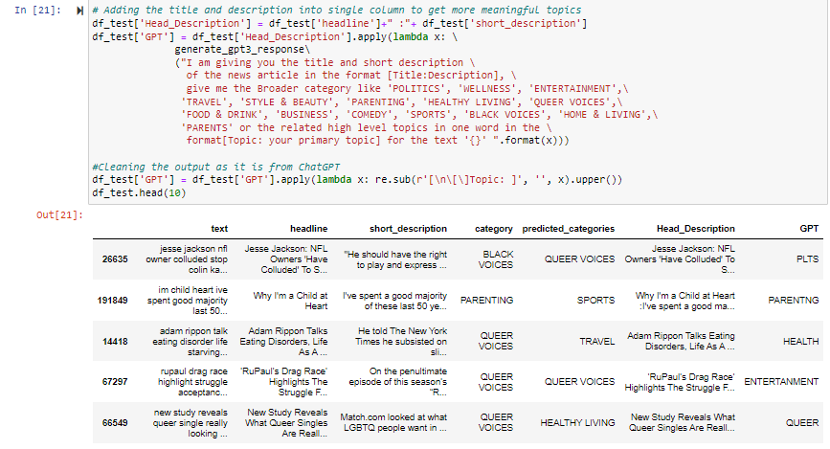
Comparison of Traditional ML Model vs ChatGPT API

Slide 7
Thank You !

